Slide 1

Theory of Computation
Equivalence of DFA and NFA
王轩
Wang Xuan

Slide 2
Outline
Prove the equivalence of DFA and NFA
Closure under the regular language
  Union
  Concatenation
  Star Operation
1

Slide 3
Proof Idea
If a language is recognized by an NFA, then we must show the existence of a DFA that also recognizes it.
How to construct the DFA?
2

Slide 4
Proof Idea
If k is the number of states of the NFA, it has 2^{k} subsets of states. Each subset corresponds to one of the possibilities that the DFA must remember, so the DFA simulating the NFA will have 2^{k} states.
3

Slide 5
Proof 1
Let N =(Q,∑, δ,q₀,F) be the NFA recognizing language A, we construct a DFA M =(Q’,∑’, δ’,q₀’,F’) recognizing A
1. First consider no ε arrows:
1) ∑_{N}=∑_{M}
2) Q’=P(Q), that P(Q) is the set of subsets of Q.
  -- Each state of M is a set of states of N
3) For R={r₁,r₂,r₃,……},R∈Q’ and a∈∑, let δ’(R, a)={q∈Q | q∈δ(r_{i} ,a)} for some r_{i}∈R}
  --δ’(R, a) = U _{ri ∈R}δ(r_{i} ,a)
4) q₀’={q₀}
5) F’={R ∈Q’|R contains an accept state of N}.
4

Slide 6
Proof 2
2. Consider ε arrows:
  Setting: E(R) as the collection of states reached from R along ε arrows in M
  Modify transition function of M to add the states that can be reached by going along ε arrows after every step.
    δ’(R, a)=(q ∈Q|q ∈E(δ(r,a) ) for some r ∈R}
    Start state of M including all possible state reached along ε arrows , q₀’=E({q₀})
5

Slide 7
Example
An NFA
Construct a DFA M containing state set:
  {∅,{1},{2},{3},{1,2},{1,3},{2,3},{1,2,3}}
1
b
a
ε
2
3
a,b
a
6

Slide 8
State sets in M
∅
{1}
{2}
{1,2}
{3}
{1,3}
{2,3}
{1,2,3}
7

Slide 9
First, determine the start and accept states of M.
  Start state is E({1}), including states reached from 1 along ε arrows and 1 itself. Thus, start state = {1,3}
  New accept states contains N’s accept state, {{1},{1,2},{1,3},{1,2,3}}
1
{1}
{1,2}
b
a
ε
2
3
{1,3}
{1,2,3}
a
a,b
8

Slide 10
Determine each state in N
  δ(1,a)=∅, δ(1,b)={2}
  δ(2,a)={2,3}, δ(2,b)={3}
  δ(3,a)= {1,3}, δ(3,b)= ∅
In DFA M:
  δ(1,a)= ∅, δ(2,a)={2,3} so in M δ’({1,2},a)={2,3}
  δ(1,b)={2},δ(2,b)={3} so in M δ’({1,2},b)={2,3}
1
b
a
ε
a
2
3
a,b
9

Slide 11
  We can get the transition function δ’({1,2},a)={2,3} and δ’({1,2},b)={2,3} in M, the other states in M following same procedure:
  δ’(∅,a)=∅, δ’(∅,b)=∅, δ’({1},a)=∅, δ’({1},b)={2},
  δ’({2},a)={2,3}, δ’({2},b)={3}, δ’({3},a)={1,3}, δ’({3},b)=∅,
  δ’({1,2},a)={2,3}, δ’({1,2},b)={2,3}, δ’({1,3},a)={1,3}, δ’({1,3},b)={2}, δ’({2,3},a)={1,2,3}, δ’({2,3},b)={3},
  δ’({1,2,3},a)={1,2,3}, δ’({1,2,3},b)={2,3}
10

Slide 12
Obtaining
a
b
a,b
∅
{1}
{2}
{1,2}
b
a,b
b
b
a
a
a
a
{3}
{1,3}
a
{2,3}
{1,2,3}
b
b
11

Slide 13
Simplify DFA by removing the unnecessary states {1} and {1,2}.
a,b
∅
{2}
b
b
b
a
a
a
a
{3}
{1,3}
a
{2,3}
{1,2,3}
b
b
12

Slide 14
a,b
a
a
b
{1,3}
{3}
∅
b
b
a
a
a
{2}
{2,3}
{1,2,3}
b
13

Slide 15


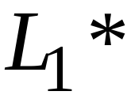
2. Closure under the regular language
We have regular language L1 and L2, we will prove that
Union:
Concatenation:
Are regular
Languages
Star:
In this lecture, we will use a new way to prove the theorems. Because the use
of nondeterminism makes the proofs much easier.
14

Slide 16




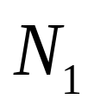
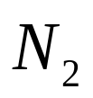
Take two languages
Regular language
Regular language
NFA
NFA
15

Slide 17
2.1 Union
NFA for
ε
q₀
ε
16

Slide 18
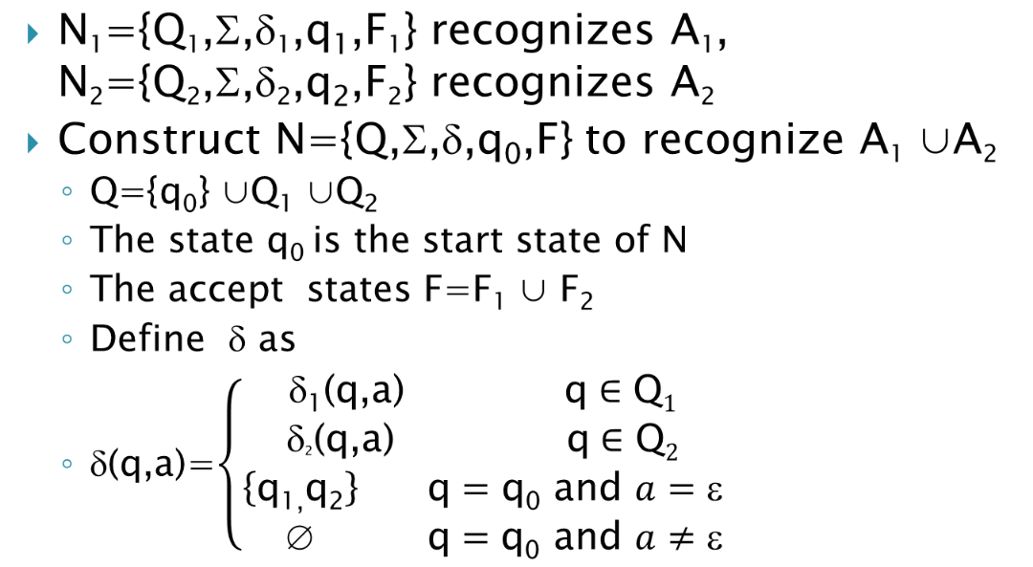
Proof
17

Slide 19
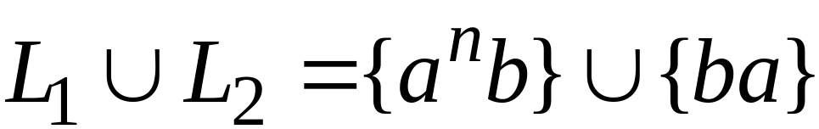

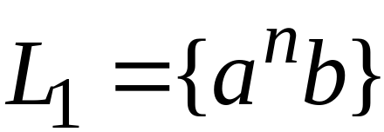

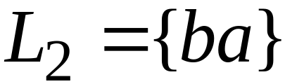
Example
NFA for
ε
ε
18

Slide 20
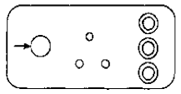
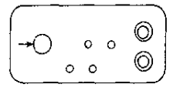
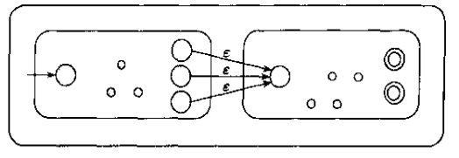
2.2 Concatenation
NFA for
19

Slide 21
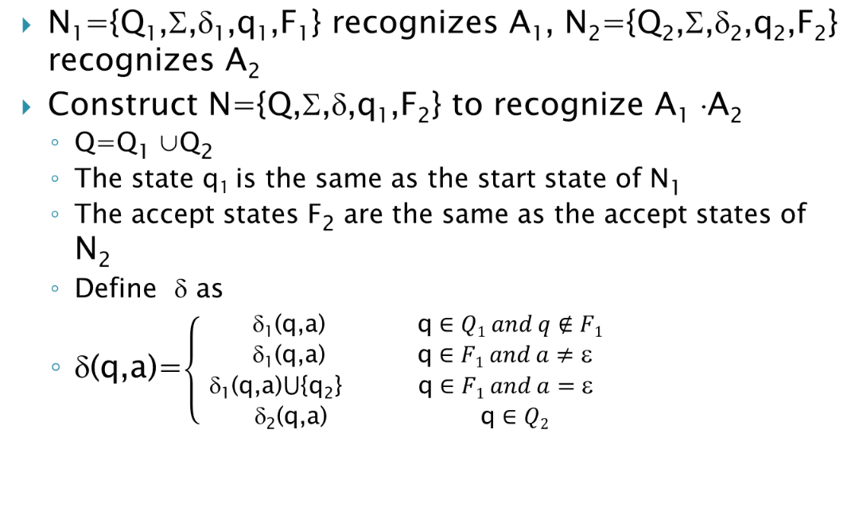
Proof
20

Slide 22
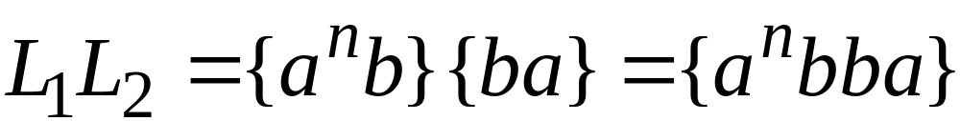
Example
NFA for
ε
21

Slide 23

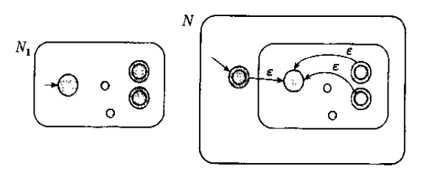
2.3 Star Operation
NFA for
22

Slide 24
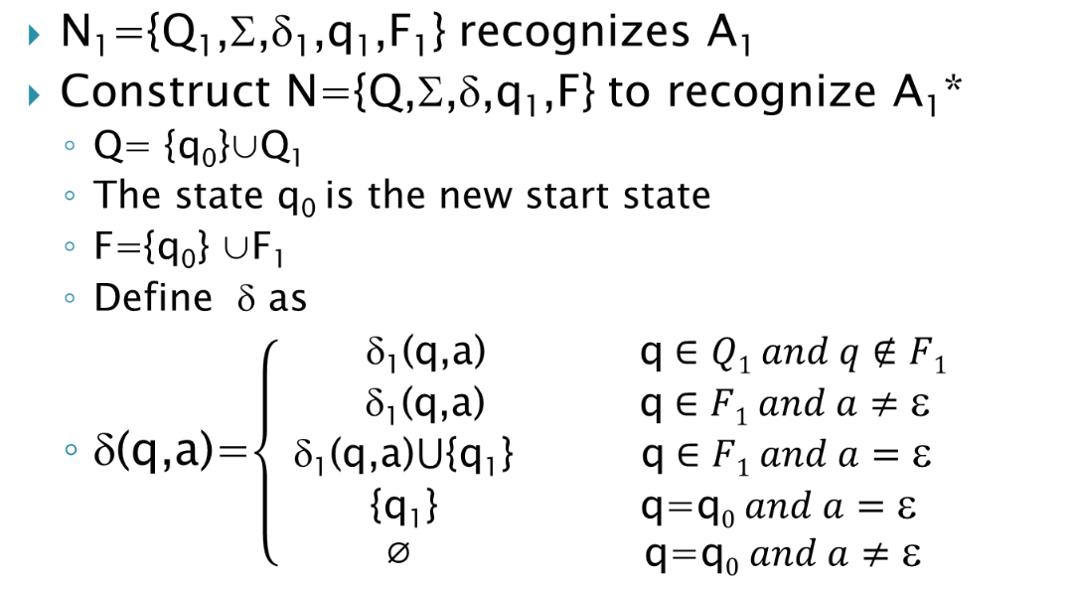
Proof
23

Slide 25
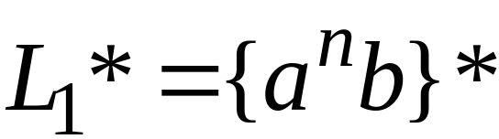
Example
NFA for
ε
ε
ε
ε
24

Slide 26
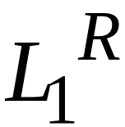


Other operations
Are also closed under regular language.
Reversal:
Complement:
Intersection:
25

Slide 27
Review
Prove the equivalence of DFA and NFA
Closure under the regular language
Union
Concatenation
Star Operation
26

